Slide 1
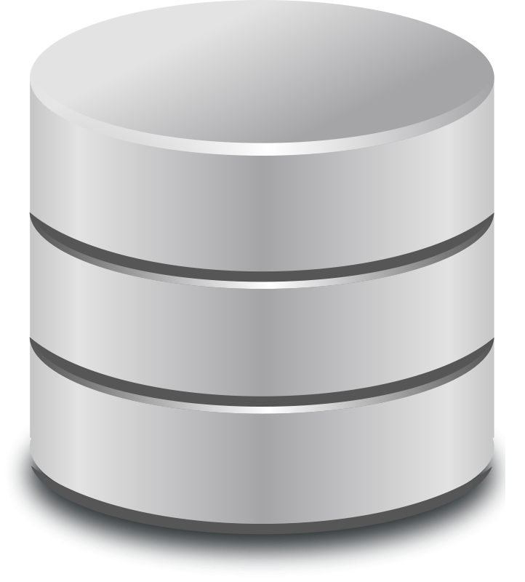
Databases

Slide 2
What is a database (DB)?
Data storage
The most simple DBs: RAM, file system, local storage
Usually has some software with it, a database management system (DBMS).
MySQL, PostgreSQL, Oracle, MongoDB, etc.

Slide 3

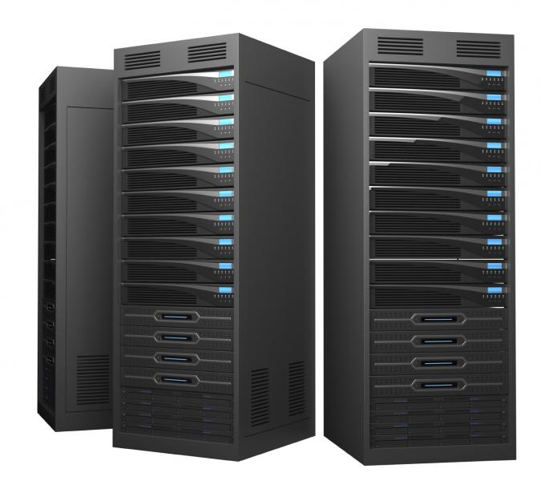

client
server
DB
client
server/DB
client/server/DB
client/server
DB

Slide 4
Types of data stores
Tables
Documents
Key-value

Slide 5
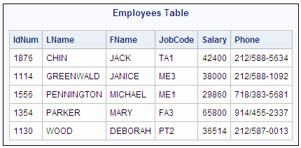
Table stores (SQL)
MySQL, PostgreSQL, SQLite, Oracle, Microsoft SQL

Slide 6
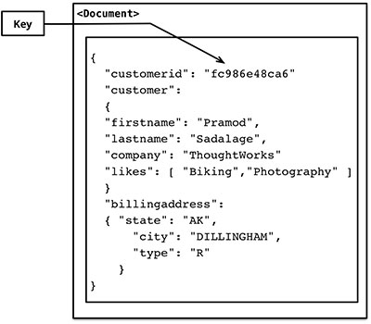
Document stores
MongoDB, CouchDB

Slide 7
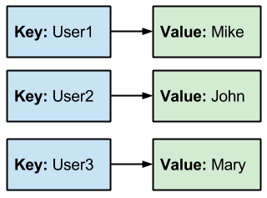
Key-value stores
Redis, Riak

Slide 8
Popularity
http://db-engines.com/en/ranking

Slide 9
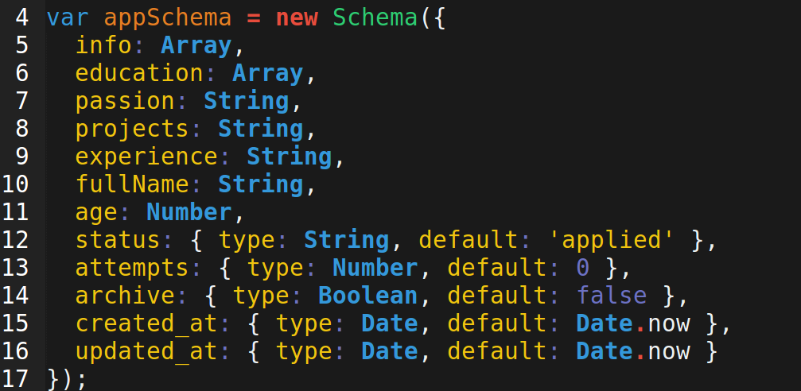
Schema

Slide 10
Comparison
Key-value: no schema
SQL: Schema striclty enforced. Table columns are defined and nothing goes into the table unless there is a column for it and its the right data type.
Document: Doesn't normally enforce a schema. The objects can have any keys and values, but you can decide on a schema anyways.

Slide 11
Relations
One-to-one
One-to-many
Many-to-many

Slide 12
One-to-One SQL
users
id | name | email | house_id
1 | 'eh' | ... | 13
2 | 'ew' | ... | 8
3 | 'ed' | ... | 6
houses
id | street | squ_ft | user_id
8 | 'beethoven' | 1900 | 2
9 | 'via marina' | 1200 | 4

Slide 13
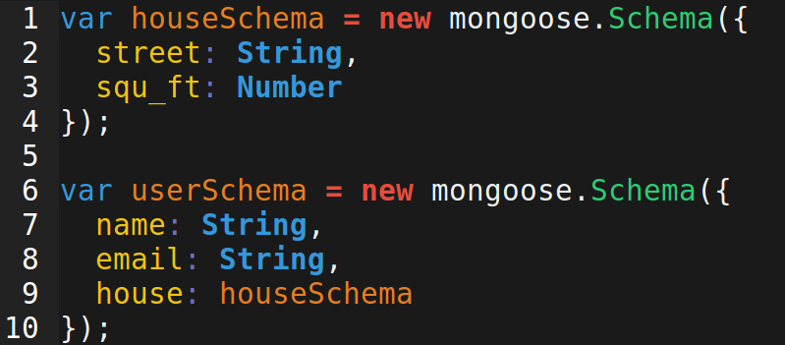
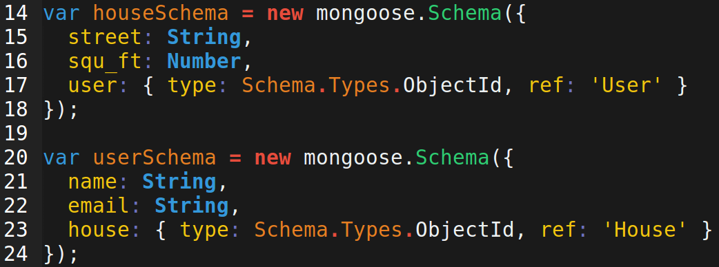
One-to-One Document

Slide 14
One-to-Many SQL
users
id | name | email | favorite_food_id
1 | 'eh' | ... | 13
2 | 'ew' | ... | 8
3 | 'ed' | ... | 13
foods
id | name | group | price
8 | 'corn' | 'veggie' | 5
9 | 'popcorn' | 'snack' | 4

Slide 15
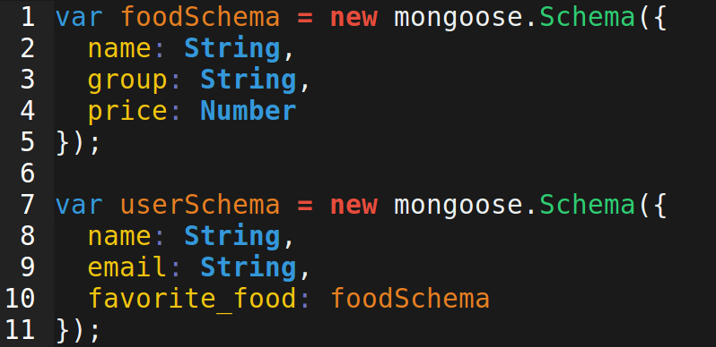
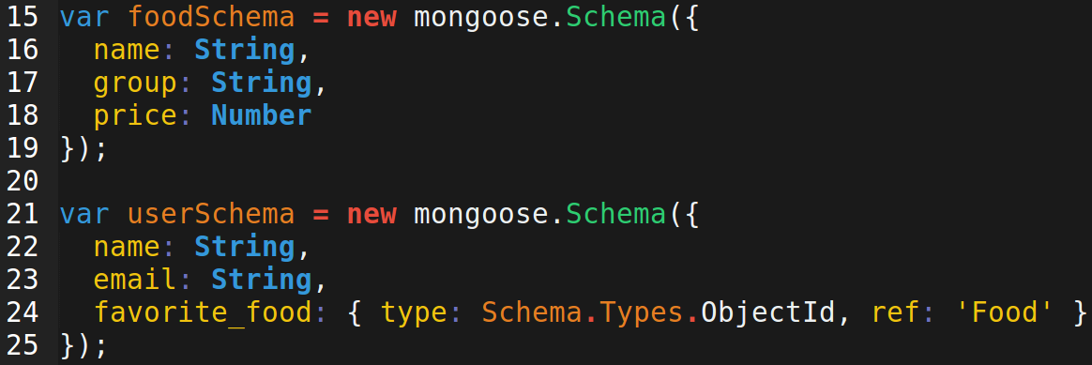
One-to-Many Document

Slide 16
Many-to-Many SQL
users
foods_users (join table)
id | name | email
1 | 'eh' | ...
2 | 'ew' | ...
3 | 'ed' | ...
id | user_id | food_id
1 | 1 | 8
2 | 1 | 9
3 | 24 | 9
4 | 3 | 16
foods
id | name | price
8 | 'corn' | 5
9 | 'popcorn' | 4

Slide 17
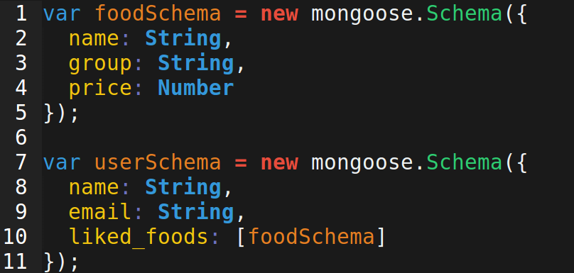
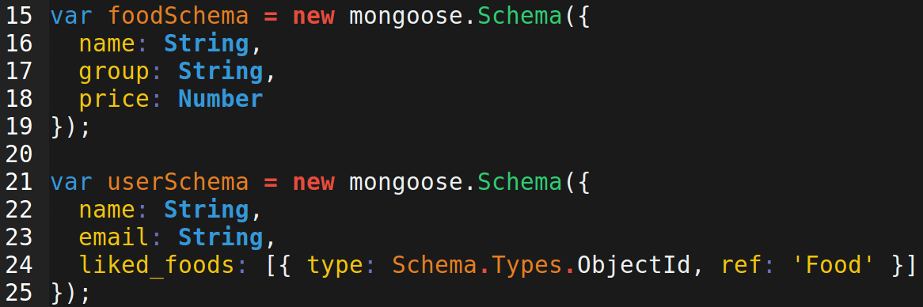
Many-to-Many Document

Slide 18
Object-Relational Mapping (ORM)
Libraries/frameworks that provide more automated way to use a DB.
Convert database records (rows/documents) into objects in your server-side language.
Provides easy way to connect to DB.
Easily declare schema
Provides nice methods to read and write to database.

Slide 19
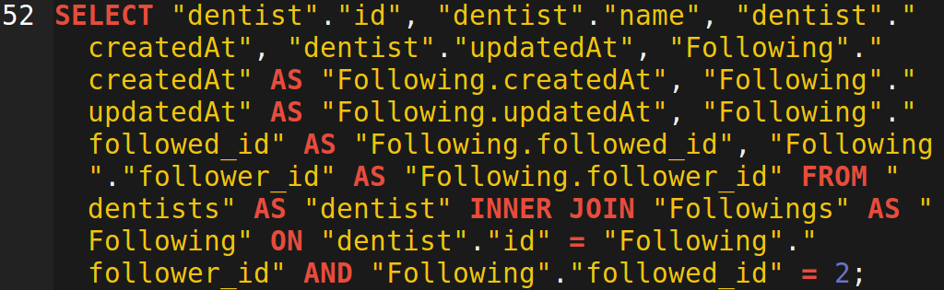
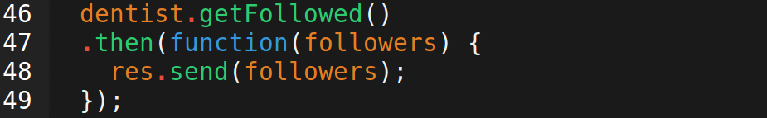
Raw SQL vs. Sequelize

Slide 20
ACID Compliance
Atomicity
Consistency
Isolation
Durability

Slide 21
Atomicity
In an atomic transaction, multiple changes to the database will all either fail or succeed. One will not happen without the other. These operations are indivisible (i.e. atomic).
Suppose A wants to give $10 to B. Subtracting 10 from A will not happen unless adding $10 to B is successful.

Slide 22
Consistency
Set of validation rules
Fields/attributes/columns are uniform
Ensure data types are adhered to
Suppose A + B must always be 100%

Slide 23
Isolation
Two transactions cannot write to the same field at once.
One transaction affecting A must wait until any other transactions affecting A are done.

Slide 24
Durability
What happens when there is a malfunction or power outage?
Does pending data get lost?

Slide 25
SQL vs. NoSQL: the bottom line
SQL databases are ACID compliant, so they are safer and more reliable.
NoSQL databases are faster.

Slide 26
CAP Theorem
Pick two of the following:
Consistency:
Availability: reads and writes can always be made
Partition Tolerance: The DB can exist across multiple servers

Slide 27
